Slide 1

Destroying the Wall to Build the Temple
2:11 – 22
Week 18
25 May 2022

Slide 2

Ephesians overview
Paul likens the church to a temple. He reviews the what, why, and how concerning this spiritual temple of salvation:
What We Once Were (2:1-3, 11-12)
  Dead in sin (2).
  Influenced by Satan (3).
  Under God’s wrath (3).
  Pagans without God (11).
  Separated from Christ (12).
  Without hope in this present world (12).
What God Did (2:4-6)
  He loved us (4).
  He liberated us (5).
  He lifted us (6).

Slide 3
Ephesians overview
Why God Did It (2:7)
  So that He might display us a trophies of his grace (7).
How God Did It (2:8–9, 13)
  Through His special favor (8).
  Through faith (9).
  Through the blood of Jesus (13).
What We Are Now (2:10, 14-22)
  We are the products of grace (10).
  We are partners with Israel (14-18).
  We are the people of God (19).
  We are pillars of the temple (20-22).

Slide 4
Ephesians overview
In the second half of chapter two (2:11-22), Paul wants Gentiles to remember how far they have come, courtesy of Jesus Christ. Once strangers from the promises made to Israel and without God in the world, Gentiles can now draw near through the blood of Jesus.
By His death on the cross, Jesus abolished the law of commandments which separated Jews and Gentiles, and has reconciled them both to God in one body (church). The Gentiles can therefore be fellow-citizens and members of God’s family; they are also part of that grand temple being built upon the foundation of the apostles and prophets with Jesus as the cornerstone, in which they serve as a habitation of God in the Spirit.

Slide 5
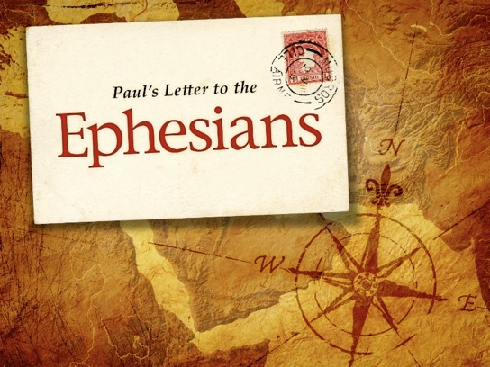
Destroying the Wall to
Build the Temple

Slide 6
Ephesians 2:11 – 22
For nearly half a century, the Iron Curtain split Europe into east and west. The separation was physical, political, and spiritual.
Physically, a heavily militarized border cut like an ugly, jagged scar from the Baltic Sea in the north to the Adriatic Sea in the south.
Politically, it separated the Communist east from the capitalist west, a division epitomized by the infamous Berlin Wall spitting East Berlin and West Berlin.
Spiritually, the Iron Curtain served as a seemingly impenetrable barrier to the gospel, blocking the atheistic Communist nations from the encroaching influence of Christianity.

Slide 7
Ephesians 2:11 – 22
From 1945 to 1989, the Iron Curtain separated families, friends, nations, and languages, resulting in enmity, animosity, distrust, and fear.
Yet in 1989, a minor miracle occurred. Just two years after US president Ronald Reagan stood before the Berlin Wall and challenged his Soviet counterpart, Mikhail Gorbachev, to “tear down this wall,” citizens from both East and West Berlin were permitted to demolish the barrier and reunite the once-divided people.
Amidst tears of joy and days of celebration, the Iron Curtain was lifted from Germany, marking the beginning of a new era in modern European history.

Slide 8
Ephesians 2:11 – 22
As much as the fall of the Berlin Wall made an unforgettable mark on the men and women who witnessed it, this historic event can’t compare to the epochal moment when Jesus Christ torn down another wall—one that had separated humanity for centuries.
Though the wall had been meant to preserve God’s Jewish people from moral and spiritual corruption as they represented their God before the nations, it quickly became a divider that alienated the Gentiles, who were meant to receive God’s blessing through the Jewish nation (Gen 26:4).
The Law of Moses and the sacrificial system had marked God’s path of holy living for the Jews. Yet Gentiles stood outside the gate, aliens to the promises, foreigners to the covenant, and dejected outcasts from the knowledge of God.

Slide 9
Ephesians 2:11 – 22
All of that changed when Christ torn down the wall (2:14) and began building a new temple (2:21-22).
In the first part of his letter to the Ephesians, Paul sharply contrasted our former lives as unbelievers, once dead in trespasses and sins (2:1), with our new lives as those made alive together with Christ (2:4-5).
Now Paul turns to another contrast—between the Gentile and the Jew. This time, however, he describes in vivid language how the deep gulf that had once separated these two peoples has been bridged by the finished work of Jesus Christ. Upon this new, level foundation of equality, a new temple, the church, is being built.

Slide 10
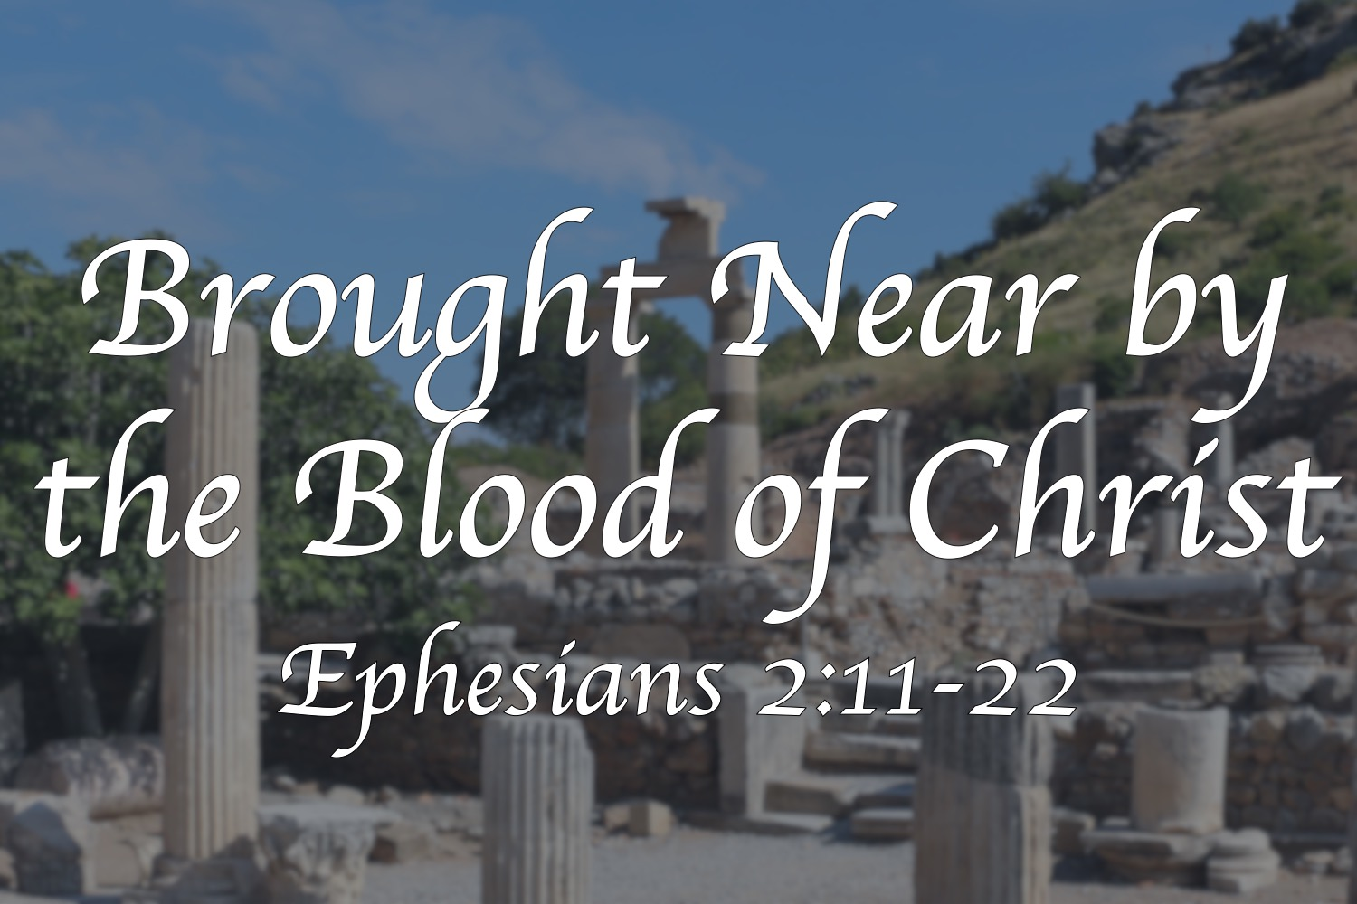

Slide 11
Ephesians 2:11 – 12
¹¹Therefore, remember that formerly you who are Gentiles by birth and called “uncircumcised” by those who call themselves “the circumcision” (which is done in the body by human hands)— ¹²Remember that at that time you were separate from Christ, excluded from citizenship in Israel and foreigners to the covenants of the promise, without hope and without God in the world.

Slide 12
Ephesians 2:11 – 12
Paul begins by describing the common plight of the “Uncircumcision”—the condition all Gentiles experienced prior to their conversion to Jesus Christ (at least from the perspective of the “Circumcision,” those Jews marked by the physical sign of the old covenant).
Verses 11 and 12 describe the lives of the Gentiles before the reconciling work of the Cross. Notice the words Paul uses to describe the Gentiles’ former relationship to God and His promises: “separate,” “excluded,” “strangers,” “having no hope,” “without God.” Paul identifies five aspects of the alienation his Gentile readers experienced prior to their salvation.

Slide 13
Ephesians 2:11 – 12
#1 CHRISTLESS. Gentiles in the first century had no thought of the Messiah. Only the Jews had hoped for a Savior, foreshadowed first in Genesis 3:15. The Jews knew He would come from among their people (Isa. 9:1-7), so they looked forward to the coming Son of David who would save them from their sins. The Gentiles, however, had no claim on the coming, anointed King.
#2 STATELESS. Being “excluded from the commonwealth of Israel,” the Gentiles had no rights of citizenship in God’s chosen nation. As the only true theocracy on earth, Israel’s ultimate King was God Himself. He ruled His people through His covenants, laws, prophets, priests, and kings. The Gentiles were foreigners to God’s nation.

Slide 14
Ephesians 2:11 – 12
#3 FRIENDLESS. When God established His covenant with Abraham (Gen. 12:1-3), the patriarch of the Hebrew people was referred to as God’s “friend” (2Chr. 20:7). As heirs of God’s covenant promises, the descendants of Abraham also enjoyed that special friendship with God.
Through the land covenant (Deut. 28-30), the Davidic covenant (2Sam. 7:8-16; Ps. 89), and the promise of the new covenant (Jer. 31:31-34; Ezek. 36:22-30), God unfolded this special relationship with the Jewish people. However, Gentiles, strangers to the promises of God, had no part in these covenants.

Slide 15
Ephesians 2:11 – 12
#4 HOPELESS. With no Savior, no home, and no promises, the Gentiles had no meaningful future. Because the promises rested with the Jewish Messiah, they couldn’t expect their situation to improve—either in this life or in the life to come. They were faced with the same conclusion that Satan faced in Milton’s Paradise Lose: “Thus repulsed, our final hope is flat despair.”
#5 GODLESS. Though the Gentiles honored and worshiped many gods, none of those lifeless gods could save them from their hopeless condition of spiritual death. Only the living God of Israel could give them what they really needed—life from the dead!

Slide 16
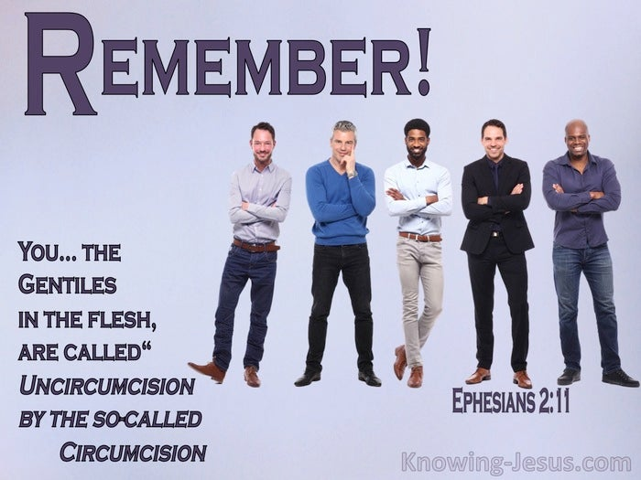

Slide 17
Ephesians 2:13 – 14
¹³But now in Christ Jesus you who once were far away have been brought near by the blood of Christ. ¹⁴For he himself is our peace, who has made the two groups one and has destroyed the barrier, the dividing wall of hostility.

Slide 18
Ephesians 2:13 – 14
Like a tidal wave smashing against an immovable cliff, the unrelenting waves of hopeless despair are broken on the second of Paul’s famous contrasts: “But now” (2:13). Having described the Gentiles’ common plight before coming to Christ, Paul reveals the cure: the Cross of Jesus Christ.
Christ first brought the far-off Gentiles near to Him. He made it possible for the hopeless and helpless of every age—from the first century to the twenty-first and beyond—to approach Him through faith. By the blood of Jesus Christ—His death in our place—God has provided our means of reconciliation. Consider the numerous “But Now” we experience through Christ . . .

Slide 19
Ephesians 2:13 – 14
We were once Christless, but now we are “in Christ Jesus.”
We were once stateless, but now we are full citizens.
We were once friendless, but now we are members of God’s family.
We were once hopeless, but now we are promised a glorious future.
We were once godless, but now we can call God our Father.

Slide 20
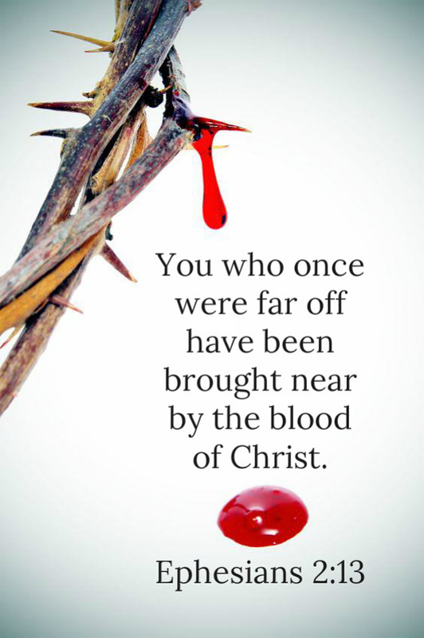

Slide 21
Ephesians 2:13 – 14
In short, When Jesus Christ paid the penalty for the sins of all humanity—Jews and Gentiles alike—the wall of separation crumbled.
Christ Himself—and Christ alone—is our peace (2:14). Christ has bestowed this gift upon us by grace alone through faith alone. What a glorious truth! Christ alone is peace personified. Centuries earlier, Isaiah prophesied that the promised child born of the family of David would be called “Prince of Peace” (Isa. 9:6).
Through the baptism of the Holy Spirit, every believer shares a common union of peace with each other: whether Jew or Gentile; male or female; black, white, Asian, or Hispanic; rich or poor; educated or uneducated; strong or weak.

Slide 22


Slide 23
Ephesians 2:13 – 14
Paul mentions the “barrier of the dividing wall” broken down by Christ. He likely had in mind the dividing wall that separated Jews from Gentiles in the massive temple complex constructed by Herod in the first century BC.
The Gentiles could look down at the temple from afar, but prejudicial customs, strict temple laws, thick walls, and stern notices prevented non-Jews from getting any closer. So when Paul said that Christ’s death broke down the diving wall, he meant that the covenant of the Law that formed the basis of such cultural and religious distinctions was no longer in force. In Christ, the separation between Jew and Gentile has been rendered obsolete!

Slide 24


Slide 25
Ephesians 2:15 – 16
¹⁵By setting aside in his flesh the law with its commands and regulations. His purpose was to create in himself one new humanity out of the two, thus making peace, ¹⁶and in one body to reconcile both of them to God through the cross, by which he put to death their hostility.

Slide 26
Ephesians 2:15 – 16
Christ’s sacrificial death on the cross abolished “the enmity.” This term indicates the opposite of friendship. Here, Paul defines “the enmity” as “the Law of commandments contained in ordinances” (2:15). In fact, the cross of Jesus Christ has put enmity to death (2:16).
Broken down . . . abolished . . . put to death—these are the terms Paul uses to describe the Old Testament Law of Moses. All of the laws, commandments, ordinances, rules, and regulations that had both condemned us before God and separated us from His people have been done away with. No wonder Paul can confidently proclaim in Romans 10:4 that “Christ is the end of the law for righteousness to everyone who believes.”

Slide 27
Ephesians 2:15 – 16
Though we are under the “law of Christ,” empowered to live like Him by the Spirit (Gal. 5:16), we are not obligated to keep the Law of Moses.
Paul doesn’t merely point out what the Cross has negatively accomplished by destroying the old religious system of the Law. He emphasizes what has positively taken place by the reconciling work of Christ.
Having broken down the wall that had separated Jews and Gentiles, God now calls members of both groups into the church, which is a new work, completely distinct from Israel.

Slide 28
Ephesians 2:15 – 16
Paul describes the church, the body of Christ, as “one new man” (2:15). Put another way, Jesus didn’t “Greekify” Jews or “Jewify” Greeks. Nor did he create a hybrid people called “Grews” or “Jeeks.”
Rather, Paul explicitly states that God made “one new man” from the two groups, and that one new man is the church, the body of Christ. In this way, unity has been accomplished and peace has been established.

Slide 29
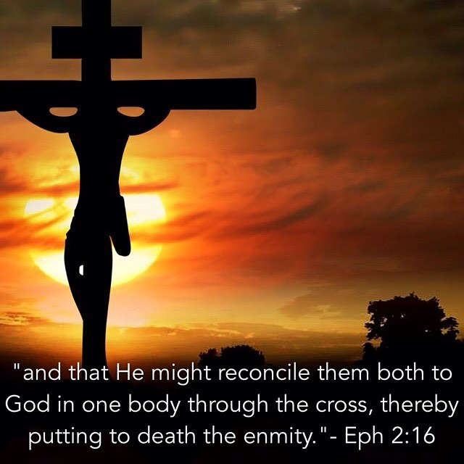

Slide 30
Ephesians 2:17 – 22
¹⁷He came and preached peace to you who were far away and peace to those who were near. ¹⁸For through him we both have access to the Father by one Spirit. ¹⁹Consequently, you are no longer foreigners and strangers, but fellow citizens with God’s people and also members of his household, ²⁰built on the foundation of the apostles and prophets, with Christ Jesus himself as the chief cornerstone. ²¹In him the whole building is joined together and rises to become a holy temple in the Lord. ²²And in him you too are being built together to become a dwelling in which God lives by his Spirit.

Slide 31
Ephesians 2:17 – 22
Paul concludes this section by explaining the peace between Jews and Gentiles based on their shared calling (2:17-19), and describing their new dwelling together in one community of the Spirit (2:20-22).
As Paul continues to explain this new unity we have in Christ, he identifies ways in which God’s people would change as a result of the demolition of the dividing wall and the building of a new structure. All of these changes center on a profound theological truth called “reconciliation.” Having been reconciled to God, both Jews and Gentiles are also reconciled to each other.
How did Jesus reconcile God’s chosen community (the Jews) with those outside of it (the Gentiles)? By embodying and proclaiming peace.

Slide 32
Ephesians 2:17 – 22
This peace is made real in our lives through the proclamation of peace (2:17). With the means of salvation in place, the message of salvation can be proclaimed and offered to both Jews and Gentiles.
In 2:17, Paul applies Isaiah 57:19 to the present proclamation of the gospel. Both personally and through His apostles, Christ preached peace both to those who were “far away” and those who were “near.”
Notice that both groups must hear and respond to the gospel in order to be reconciled to God and to each other. Though the Jews were near in the sense of having heard the prophecies, heeded the Scriptures, and anticipated the fulfillment of the promises, these alone were not enough to save them.

Slide 33
Ephesians 2:17 – 22
Like everybody else, they needed to trust in Christ alone by faith alone for their salvation. Nobody can be “grandfathered into” the church, and none of us receive the Holy Spirit by passive osmosis. Each of us must trust Christ for himself or herself, thus receiving the Spirit by faith. It’s true for all of us.
In addition to being reconciled with God and with each other, all those who believe in Christ have become part of one new humanity at peace with God. What does this peace actually look like on a daily basis?
Paul describes four things we all share because of our new relationship with one another . . .

Slide 34
Ephesians 2:17 – 22
FIRST – our new relationship of peace manifests itself in equal and unhindered access to the Father by the Spirit (2:18). This may not seem like an important development to those of us who have know common access to God for nearly two thousand years.
In Paul’s day, however, this was an earthshaking change for both Jews and Gentiles. Jews could only access God through their high priest, who entered God’s presence once a year on the Day of Atonement (Lev. 16). Gentiles could only have access to God by converting to Judaism, receiving circumcision, and following the Law as a Jews.
Yet Christ’s death tore the curtain in the temple in two from top to bottom (Matt. 27:50-51), demonstrating that in Christ all believers have direct access to God.

Slide 35
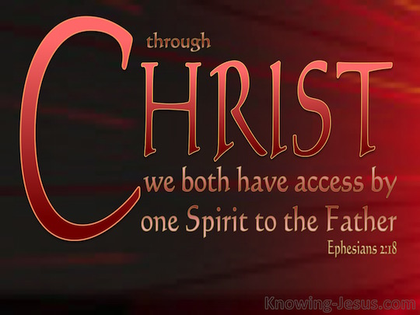

Slide 36
Ephesians 2:17 – 22
Here, we see the work of the triune God in the plan of reconciliation—we have access to God the Father through the empowerment of the Holy Spirit because of the work of Christ.
Now we can come freely and directly to God in prayer for all our needs. No more priests, no more complex rituals, no more fear that we might be consumed by His holy wrath. Rather, we have a common access to God’s presence that is free and complete, granted to all who believe.

Slide 37
Ephesians 2:17 – 22
SECOND – Paul explains that the peace we have in Christ confers on us a citizenship among the saints (2:19). The Gentiles had once been foreigners who had no rights or privileges among the people of God. In Christ, they became “fellow citizens with the saints.”
Here, Paul is referring specifically to Old Testament saints—those with whom Gentiles formerly had nothing in common. Now, though, as saints themselves, Gentile believers are on an equal standing with the great patriarchs and prophets of old—Abraham, Moses, Joshua, David, Elijah, etc . . . They’re in great company!

Slide 38


Slide 39
Ephesians 2:17 – 22
THIRD – Paul tells us that we relate to each other as a family, as fellow members of “God’s household” (2:19). In the New Testament, the “household” referred to all those living under the same roof, so to speak. It often included more than what we call the “nuclear family.” It might include parents, children, grandparents, grown sons with their own wives and children, even aunts and uncles.
In other words, it included the “extended family.” This is a great picture of the new family of God, united under one Father through the person of Jesus Christ and held together by the bond of the Holy Spirit.

Slide 40
Ephesians 2:17 – 22
Though all of us know that most families deal with some level of dysfunction, the church family should strive to live together as loving brothers and sisters in Christ, regardless of the differences in our racial, social, economic, and cultural backgrounds. This kind of community life brings great benefits to everyone.
It provides us with a caring network of support that goes beyond that of friends and neighbors. It gives us a place for mutual accountability and growth. It gives us an opportunity to exercise our spiritual gifts for the benefit of all. And it also provides a beautiful example of love for those outside the Christian faith looking in.

Slide 41
Ephesians 2:17 – 22
FINALLY – Paul reveals that Jews and Gentiles today have a common faith (2:20-22). Paul uses the image of a temple building to describe the Christian faith community into which both Jews and Gentiles are welcome. The foundation of the building consists of the teachings of the New Testament apostles and prophets, with the person and work of Jesus Christ Himself as the cornerstone of the whole structure.
In the first century, while the New Testament was still being written by those apostles and prophets, the foundation consisted of their teachings from the Old Testament and their eyewitness accounts, not to mention the small but growing number of writings that became part of our New Testament.

Slide 42
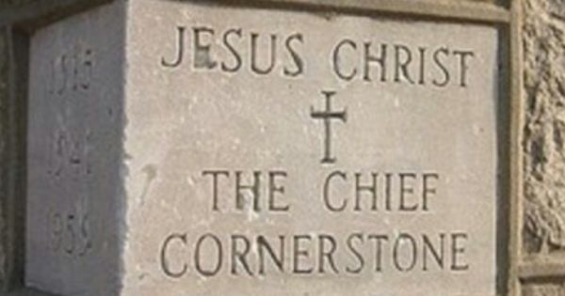

Slide 43
Ephesians 2:17 – 22
Today, we have direct access to all of the inspired writings of both the Old and New Testaments, both of which point to Jesus Christ as the center and standard of truth.
As God calls each of us from our various backgrounds, He fits us together as stones in the temple, firmly established on the foundation of the apostles and prophets with Christ as the cornerstone. This living building is no mere gathering of like-minded believers, but a “holy temple,” as it is the dwelling place of the Holy Spirit of God (2:21-22).
Though he doesn’t use the word here, Paul is referring to the church, the body of Christ, which is not a literal building or an earthly corporation, but a living community of faith, resting squarely on the Holy Scriptures and centered intently on Jesus Christ.

Slide 44


Slide 45



Slide 46
NEXT CLASS – 1 June 2022
Book of Ephesians
Before next class, read the below verses in the NIV and in one other versions of the Bible, i.e., NKJV, NRSV, KJV, CEV, etc …
Chapter 3:1 – 13
“The Mystery, The Ministry, and Me”

